Slide 1
Medication
Bluestep

Slide 2
Entering medications prescribed
Hit Select Resident
Select resident
Hit Select
Select Medication Prescribed
New entry
Medication label must match the MAR (Ex. Lasix commonly sent as Furosemide)
Enter all the information that has an * by it.
Notes:
The physician instructions will not show up on the MAR the MAR instructions will show up on the MAR. Make these as close to laymens terms as possible.

Slide 3
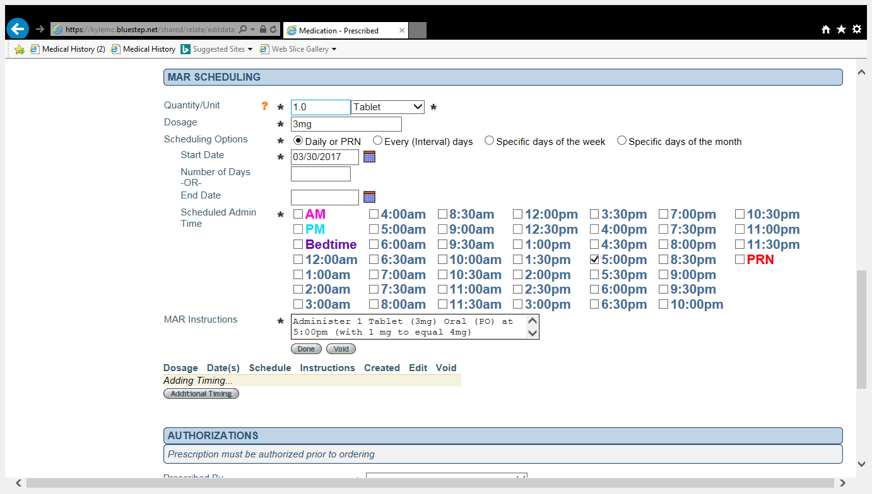
Additional timing (multiple dosing)
Enter the medication as a normal medication prescribed and hit done.
Then do additional timing and enter the orders as given.
Example

Slide 4
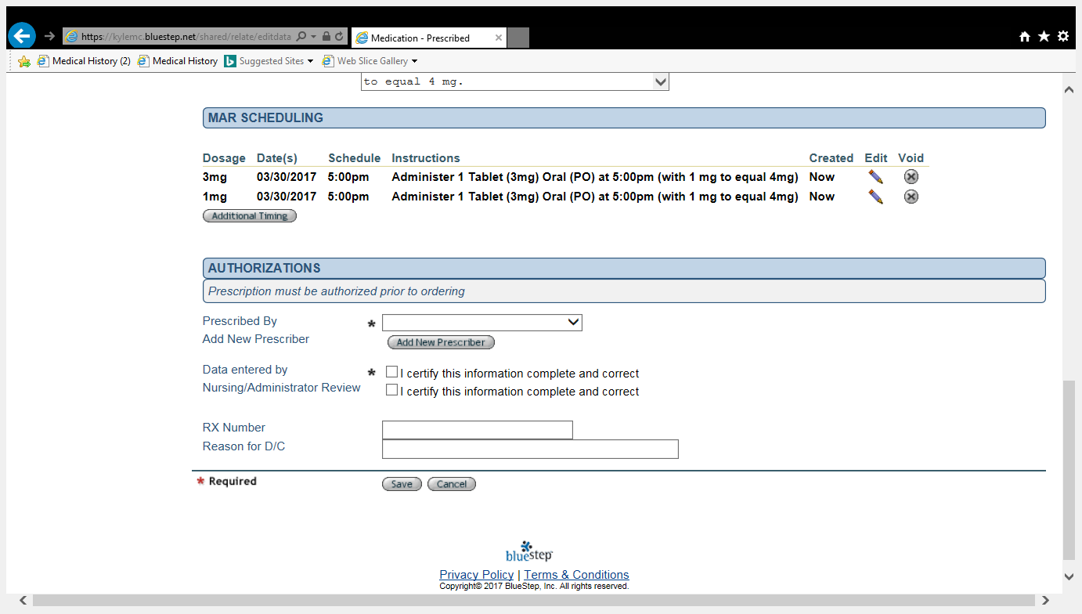
Example of additional timing, continued from previous slide.
Make sure to complete all boxes with the * symbol and hit save. Once you hit save you cannot make any changes to add times but you may change times given. Also you cannot change dosage amount you must discontinue and copy then you can change.

Slide 5
Discontinued medications
Select the medication
Select Pencil to edit
Check the DC the medication box
Enter the Reason for D/C
Now if you are discontinuing completely hit the save button. If you are changing the dosage amount, adding or subtracting the number of doses, you must do the following: Check the D/C medication box
Enter the reason
Hit COPY not Save

Slide 6
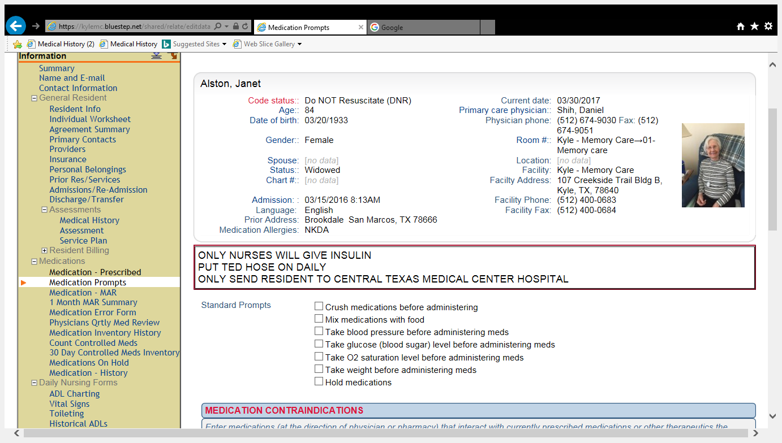
Medication prompts
Select Resident
Select Medication Prompts from drop down menu on the left
Examples (Standard prompts)

Slide 7
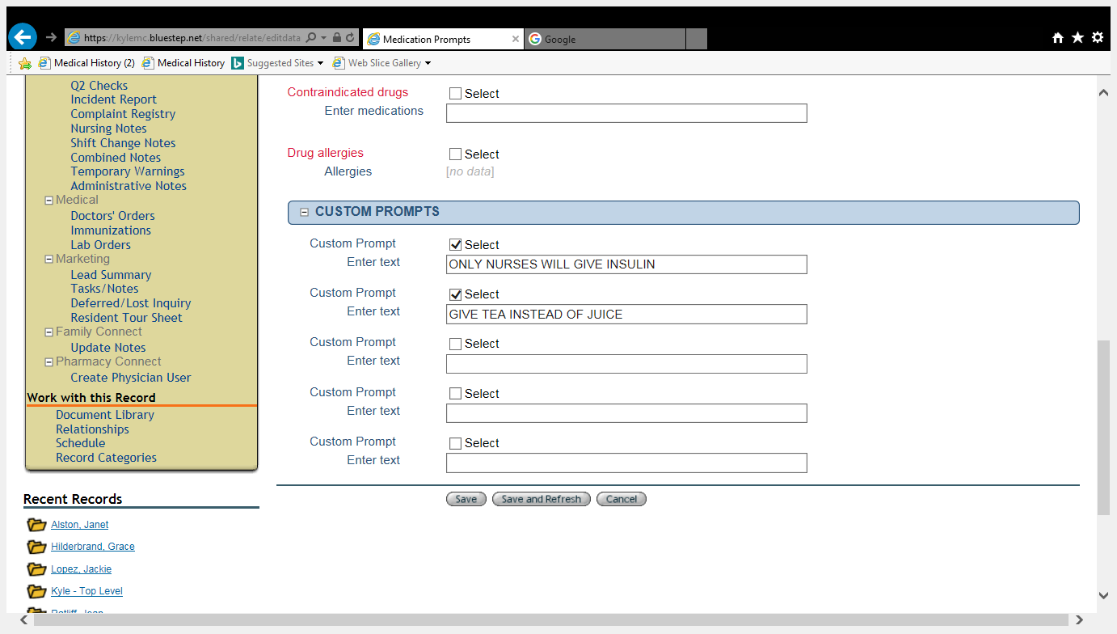
Medication prompts cont’d 1st location in bluestep to enter
Custom Prompts can be entered two ways.
Select resident
Select Medication prompts (see below)

Slide 8
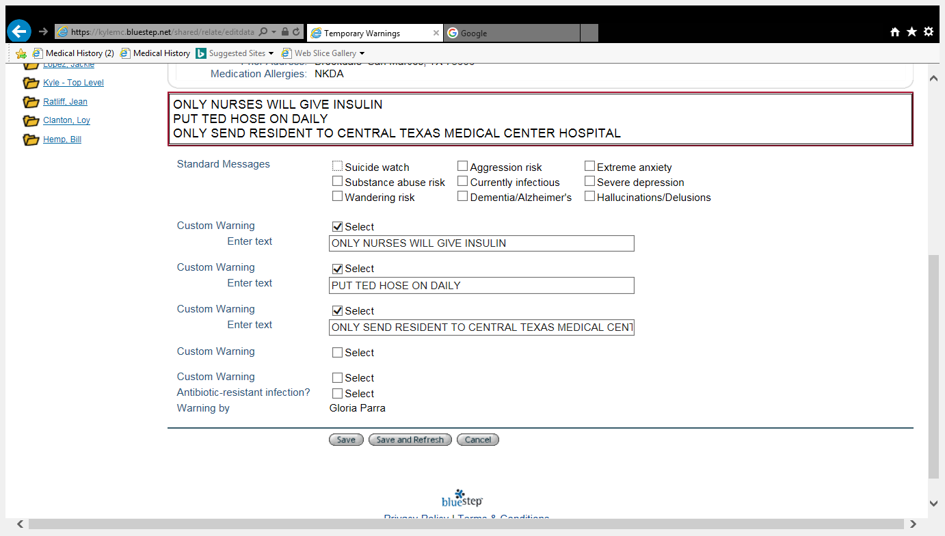
Medication prompts cont’d 2nd location in bluestep to enter
Select resident
Select Temporary warnings from drop down menu on the left (see below)

Slide 9
1 month mar summary current and past months meds administered/not administered
This shows all the current and dc’d medications for the current month or past months
It also shows who gave/did not give the medication
The initials with a number is an indication that there was something that happened when giving medication. (Example, resident refused, prn not needed or dropped or notes of blood sugar, blood pressure etc…..)
Dashed line in the date box indicates medication or treatment discontinued.
See next slide for example

Slide 10
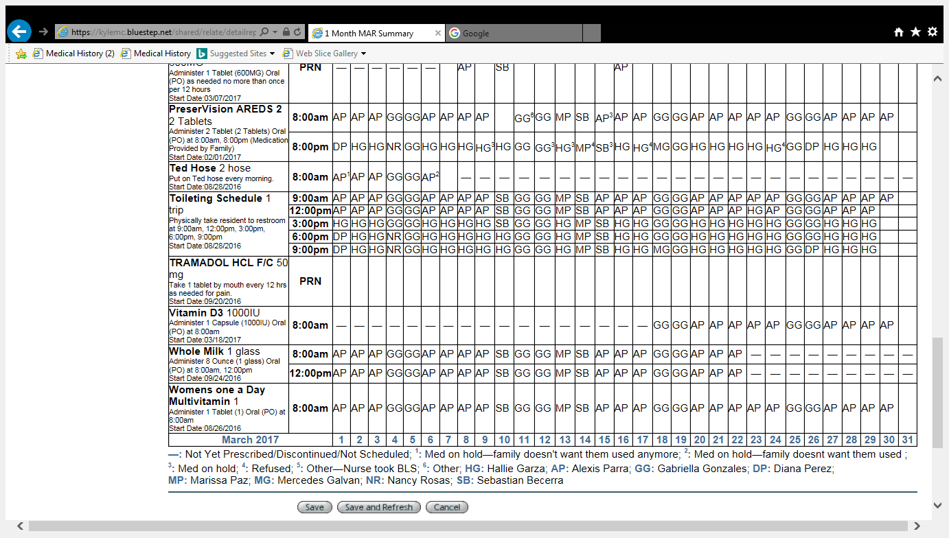
tr

Slide 11
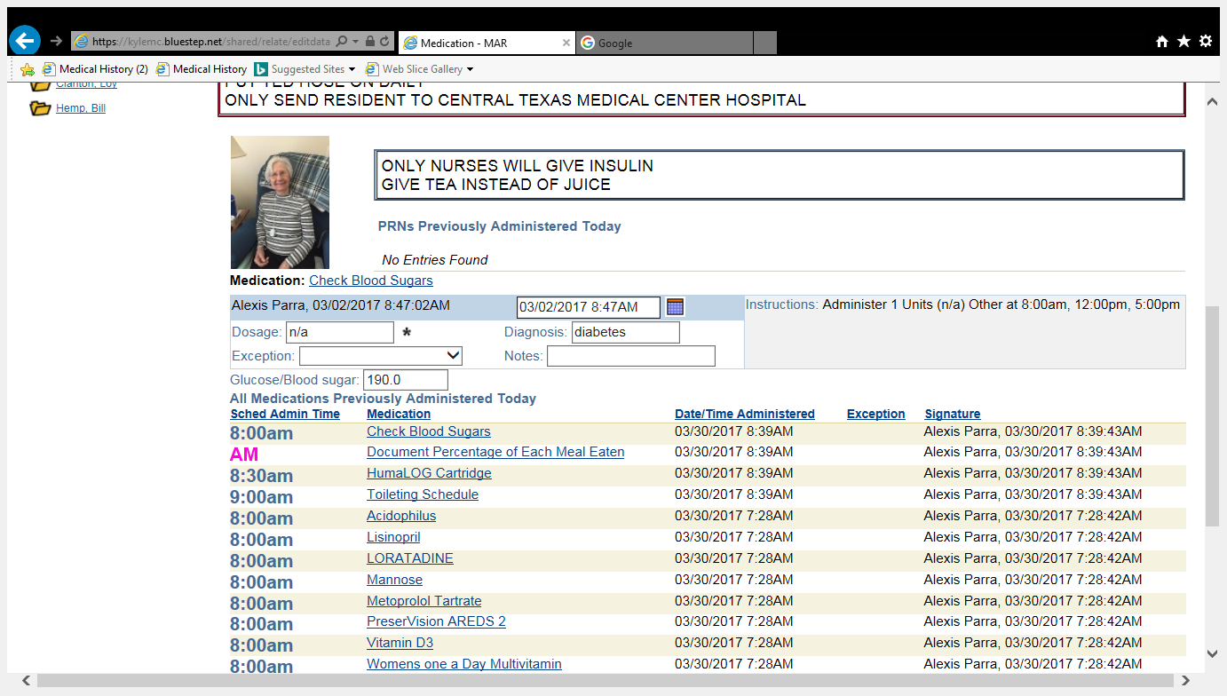
Changing administration times or changing that medication was not given, because accidently saved as given
Select resident
Select 1 month MAR summary
Make sure you are on current month if not change date to the 1st of the current month and hit save and refresh
Find the medication and time you are wanting to correct
Click on that time and should look as follows:
You can make changes in the boxed area
Then hit save and changes will be made
You check the changes by repeating from click
medication time administered
You cannot change any information on a medication that has been discontinued and the administration box has a dash (-), must enter nurses note for explanation

Slide 12
Medication error form only used for errors that do not require follow up
Select resident
Select medication error form, from drop down menu on the left
New entry
Select medication
Enter the information in the boxes with the (*) symbol
Enter what happened in Medication error box
Save
This is used for the following errors:
Medication dropped, resident refused, prn refused, family refused, order clarification
Resident spit out, etc….
If the MEDICATION WAS GIVEN TO THE WRONG RESIDENT DO NOT USE THIS.
USE THE PAPER MED ERROR FORM ON THE E BINDER.

Slide 13
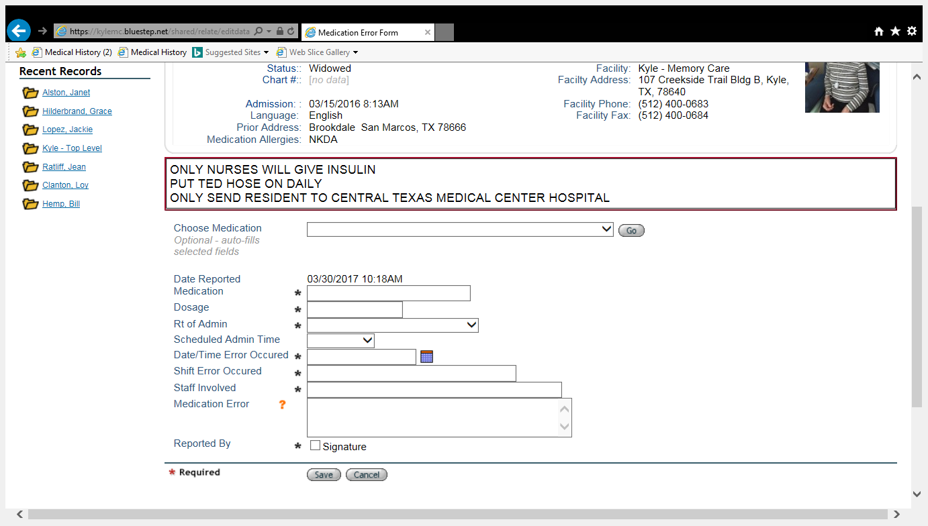

Slide 14
Physicians quarterly med review
This is used when residents need a new prescription or are going for their annual exam with primary care md.
You may also send this to other prescribers as well so that they may add any additional medications and can see what is being administered.
This is a valid md order or prescription that Omnicare will accept.
Note it states valid for 6 months of refills unless otherwise indicated by MD

Slide 15
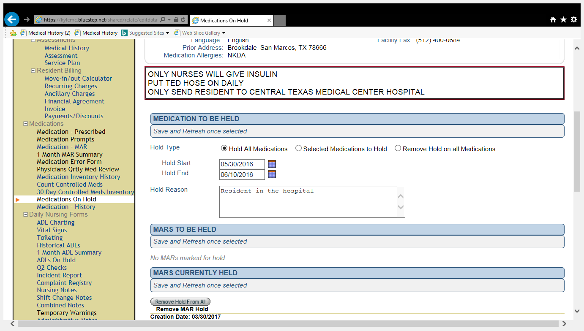
Medications on hold (2 step process)
Select resident
Select Medications on Hold from drop down menu on the left
See below
Select the hold type
Enter start and end date
Enter hold reason
Hit save
THEN YOU HAVE TO DO THE FOLLOWING:
Go back into medications on hold
Verify the hold. If you do not verify the hold it will not put medication on hold

