Slide 1
PROVIDER NETWORK
Select Add New Provider- New Haven San Angelo top level
Enter information in boxes with (*) symbol
Unit TOP LEVEL
Contact information the Home information is the same as Work Information.
Emergency contact information is for if the office has an on-call service
Provider information-if a provider does not come to the facility and resident goes to their office you make their provider type their specialty (Ex eye doctor, NP , admitting doctor)
Provider information-if a provider is rehab, hospital, clinic, minor emergency, home health or hospice you give the provider type as one of two options;
Primary care md
Physician or speacilist

Slide 2
PROVIDER NETWORK CONT’D
THESE ARE THE STEPS TO FOLLOW TO GIVE OUTSIDE AGENCIES (HOME HEALTH AND HOSPICE) DOCUMENTING PRIVELEGES
Select the provider
Select Create Physician User from drop down menu on the left
Give a username and password
Examples of username is the actual name of agency, clinic, hospice hospital etc…..
Examples of password use Welomce 1 Password 1

Slide 3
PROVIDER NETWORK CONT’D
THIS MUST BE DONE IN ORDER OR AGENCY TO HAVE ACCESS
LOGIN AS NEW HAVEN PROVER NETWORK
  URL https://newhavenprovider.bluestep.net
  Create a shortcut on the desktop
  Next login as the agency and it will prompt you to change password, so change the password from 1 to 2 etc…..
  Next you set them up on their home site by hitting HQ in very top right hand corner
  If this is first time for resident add them to the provider list on their individual record
  If they are already listed as the provider you must first create the physician user, then make provider inactive in their individual record and then make them active again. (seems redundant but will not work any other way).
  Once the resident is discharged from services please make them inactive.

Slide 4
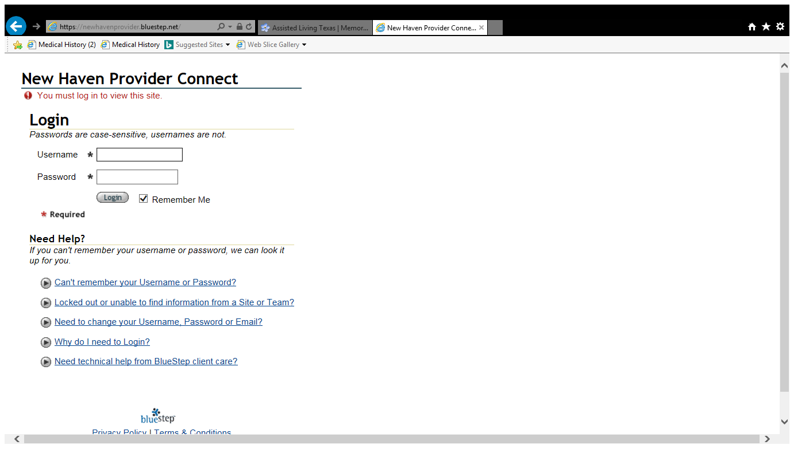
Provider Network Screen

Slide 5
How to add note to provider network
Once logged into provider network agency staff must do as follows:
  Select resident
  Select Nurses notes from left drop down menu
  New entry
  System will automatically enter date and time ( you may change date and time and even backdate if need to)
  Enter type of note Example, Physical Therapay, OT, Hospice aid, Social worker, Chaplin, and SNV etc……..
  Free hand type visit note can be as simple as Routine skilled nursing visit or can be detailed as you want it. (Per DADS surveyor the more details the less likely to visit contracted agency)
  Check the signature box and save
  REMEMBER TO LOGOUT AFTER DONE!!!!!!!!!!!!!!!!

